Slide 1
NY State Lab Review

Slide 2
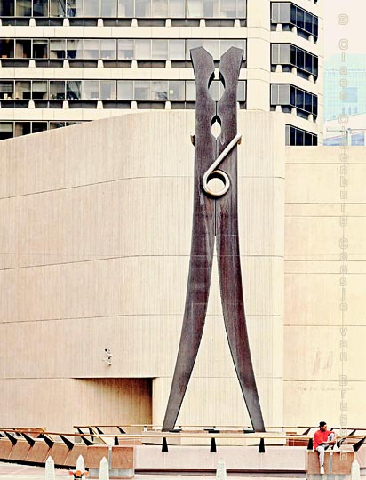
“Making Connections”

Slide 3
Making Connections
Main point – How blood circulation is related to muscle fatigue.
What did we do – We measured how exercise affected your pulse rate
What did we learn – We learned that exercise increases your pulse rate.

Slide 4
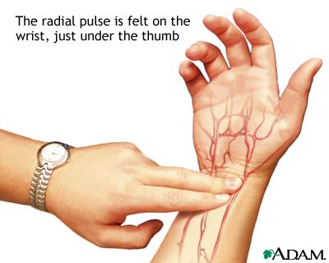
What did we do –
We took our pulse.
Then exercised for 1 minute and recorded our pulse again.
We squeezed the clothespin for 1 minute.
Then squeezed it again for another minute.

Slide 5
What we learned –
A. If you squeezed more in the second round it may have been because your muscles were warmed up from increased circulation.
B. If you squeezed less the second round it may have been because your finger muscles were fatigued.

Slide 6
How is Heart Rate related to Exercise ?
When you exercise, your cells need MORE energy which requires MORE oxygen and MORE ATP to perform cellular respiration.
Lactic Acid….
How is Heart Rate related to Exercise ?

Slide 7
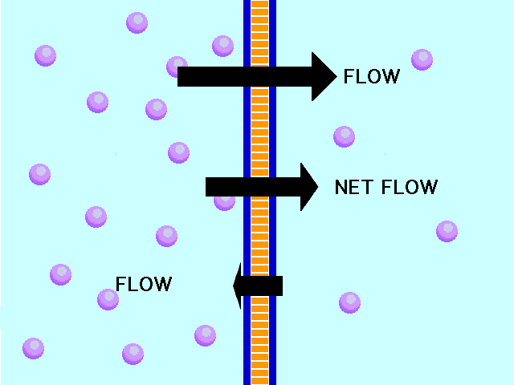
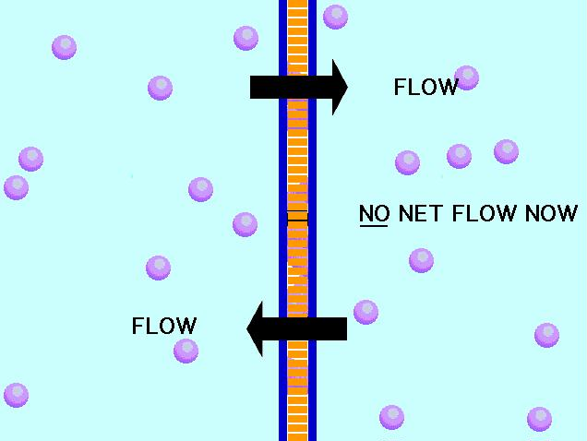
NYSED Part D Lab Review
Diffusion Through a Membrane
Lets get to Work

Slide 8
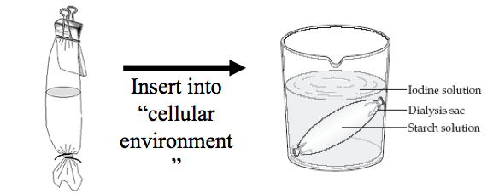
Part A
What we did –
Made a model cell using dialysis tubing
Put glucose and starch inside the cell
Put starch indicator (iodine) outside the cell
I
G
S

Slide 9
Part A
What you saw –
Inside cell turned black because iodine diffused into the cell.
Because outside was not black we know that the starch did not diffuse through the membrane.
S
S
G
I
G
G
Glucose solution (G)
G
I
G
I
G
I
I
S
S
I
I
Iodine solution (I)
I
Starch solution (S)
At the beginning…
After 15 minutes…

Slide 10
What we Learned –
Small molecules (glucose, iodine) CAN DIFFUSE through a membrane on their own.
Large molecules (starch) CAN NOT DIFFUSE through a membrane on their own.
You can use indicators to identify the presence of specific substances.

Slide 11
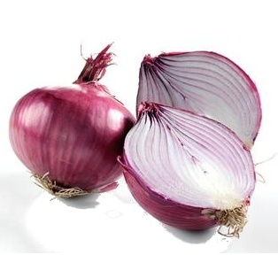
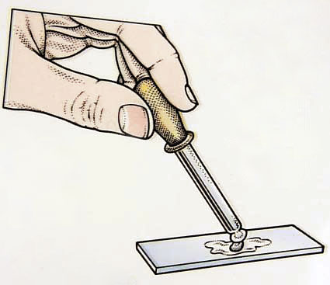
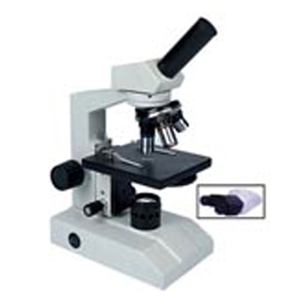
Part B
What we did –
Looked at red onion cells under microscope
Added salt water to the onion cells
Added distilled water to the onion cells
What we saw–
- Salt water caused the onion cells to shrivel and peel away from their cell walls
- Distilled water caused the cells to swell back to normal

Slide 12
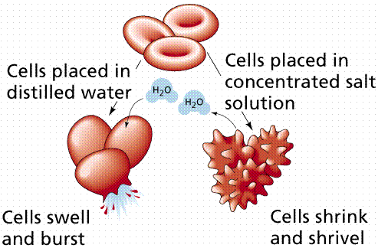
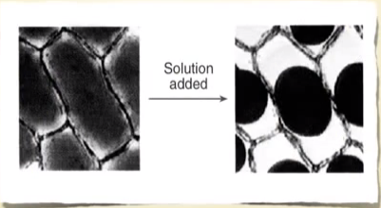
What we learned
Salt water causes water to diffuse out of a cell
Distilled water causes water to diffuse into a cell

Slide 13
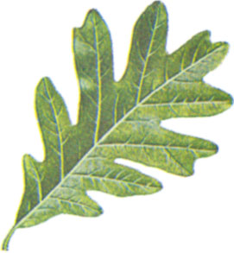
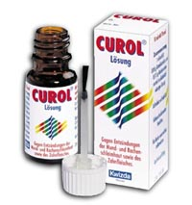
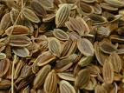
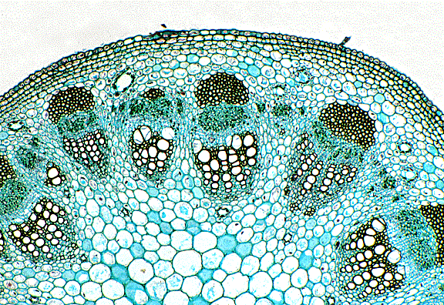
Relationships and Biodiversity

Slide 14
What did we do -
Compared 4 species of plants, based on structural and molecular traits.
What did we learn –
Species that are related share similar traits
Different techniques can be used to determine relationships between organisms
Endangered species should be protected because they may offer benefits to humans

Slide 15
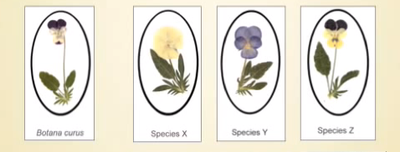
Test 1 - Structural Characteristics of Plants

Slide 16
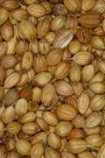
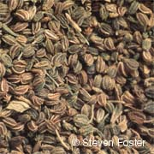
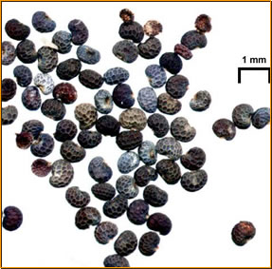
Test 2 – Structural Characteristics of Seeds
Botana curus seeds
Species X seeds
Species Z seeds
Species Y seeds

Slide 17
Test 3 – Microscopic Internal Structures of Stems

Slide 18
Test 4 – Paper Chromatography to Separate Plant Pigments
Water migrates up paper via capillary action and carries plant pigments with it.
B.curus
X
Y
Z
B.curus
X
Y
Z

Slide 19
Test 5 – Indicator Tests for Enzyme M
Botana curus
Botana curus
(“fizzed” a little)
Species X
Species X
(no “fizz”)
Indicator Enzyme M
Species Y
Species Y
(“fizzed” a little)
Species Z
Species Z
(“fizzed” a little)
Add a small sprinkle of “Indicator Enzyme M”
Put two drops of each plant Extract in separate wells of the well tray.
Record your results.

Slide 20
Test 6 – Using Simulated Gel Electrophoresis to Compare DNA
The strips below represent the DNA strands extracted from each plant (B. curus, X, Y, and Z). Each strand will be “cut” between a double C/double G. Therefore, lines are drawn below where each strip should be cut. Then, count up the number of bases and paste appropriately in the simulated Gel Electrophoresis table on the next slide.
Botana curus A T T C C G G A T C G A T C G C C G G A T A T A C T C C G G T A A T A T C
Species X A T T G T A C C G G G A T C C G G A C G T C G C G A C T A A T A T A G C A
Species Y A C C G G T C C G G G A T C G C A C C C G G T A C T C C T G T A A T A T C
Species Z A T T C C G G A T C G A T C G C C G G A T A T T C T C C G G T A A T A T

Slide 21
Simulated Gel Electrophoresis
# of Bases | Botana curus | Species X | Species Y | Species Z
24
23
22 |  | G G A C G T C G C G A C T A A T A T A G C A
21
20
19
18
17 |  |  | G G T A C T C C T G T A A T A T C
16
15
14
13
12 | G G A T C G A T C G C C |  | G G G A T C G C A C C C | G G A T C G A T C G C C
11 | G G A T A T A C T C C |  |  | G G A T A T A C T C C
10
9 | G G T A A T A T C |  |  | G G T A A T A T C
8 |  | A T T G T A C C
7 |  | G G G A T C C
6
5 | A T T C C |  | G G T C C | A T T C C
4
3 |  |  | A C C
2
1
-
+

Slide 22
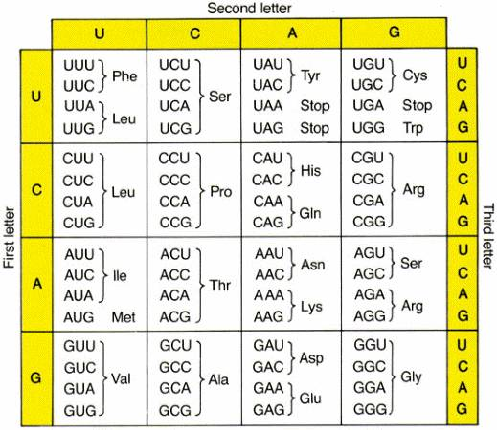

Slide 23
Test 7 – Molecular Evidence for Relationships
Botana curus | CAC | GTG | GAC | TGA | GGA | CTC | CTC
mRNA | GUG | CAC | CUG | ACU | CCU | GAG | GAG
Amino acid | Val | His | Leu | Thr | Pro | Glu | Glu
Species X | CAC | GTG | GAC | AGA | GGA | CAC | CTC
mRNA | GUG | CAC | CUG | UCU | CCU | GUG | GAG
Amino acid | Val | His | Leu | Ser | Pro | Val | Glu
Species Y | CAC | GTG | GAC | AGA | GGA | CAC | CTC
mRNA | GUG | CAC | CUG | UCU | CCU | GUG | GAG
Amino acid | Val | His | Leu | Ser | Pro | Val | Glu
Species Z | CAC | GTA | GAC | TGA | GGA | CTT | CTC
mRNA | GUG | CAC | CUG | ACU | CCU | GAA | GAG
Amino acid | Val | His | Leu | Thr | Pro | Glu | Glu

Slide 24
What type of evidence is more reliable structural or molecular ?
Molecular is more reliable.
- Species can look similar if the inhabit the same habitat (Shark / Dolphin).
- Similar genes show evidence of sharing a more common ancestor.

Slide 25
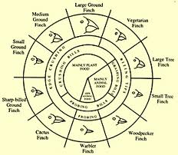
The Beaks of Finches

Slide 26
What we did –
Had finches with different beaks compete for food
What we Learned –
Different environmental conditions (food) favored different species of finches (beaks) allowing some to survive and reproduce but not others
Natural selection, competition and variation drive evolution.

Slide 27
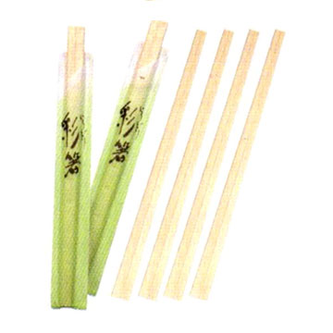
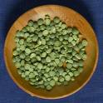
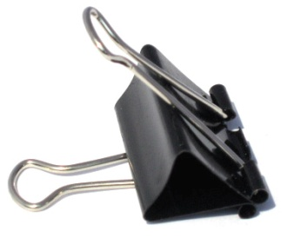
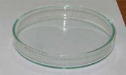
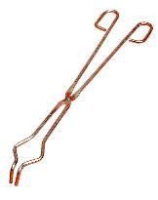
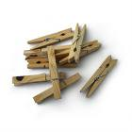
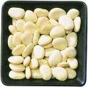
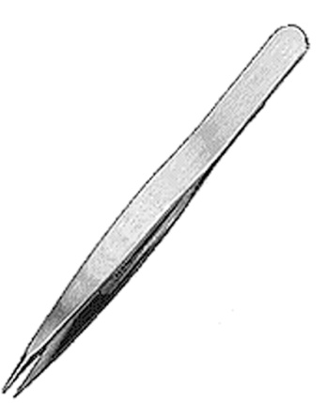
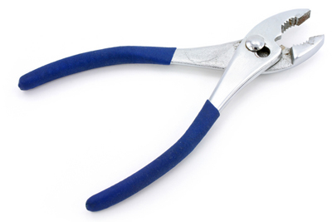
Supplies
A randomly assigned “beak”
Small seed island
Petri dish
Large seed island
Timer

Slide 28
And now, Round 1…
 |  | Seeds Collected
Partner #1 | Trial #1
Partner #1 | Trial #2
Partner #2 | Trial #3
Partner #2 | Trial #4
 | Average
Did you average over 13 seeds?
YES
NO
Go to Round 2 Increased Competition
Repeat Round 1 on the “big seed” island with the same beak

Slide 29
Successful in Round 1? Welcome to Round 2!!!
Repeat the same procedure but this time have another “bird” to compete against!
Round 2 - Increased Competition
 |  | Seeds Collected
Partner #1 | Trial #1
Partner #1 | Trial #2
Partner #2 | Trial #3
Partner #2 | Trial #4
 | Average
Compete the table and move on to Round 3 where there is “Increased Competition” if you average over 13 seeds.

Slide 30
Unsuccessful in Round 1?
Go to a “large seed” island and start over (even though you have starved to death, you are resurrected)
 |  | Seeds Collected
Partner #1 | Trial #1
Partner #1 | Trial #2
Partner #2 | Trial #3
Partner #2 | Trial #4
 | Average
Did you average over 13 seeds this time?
YES
NO
Go to Round 2, but with another large seed eater as competition on the “large seed” island
Get a new “beak” and try yet again
(not a possibility in nature)

Slide 31
Successful in Round 2? Welcome to Round 3!!
Increased Competition
(more than 1 other bird)
Repeat the same procedure but this time have even more birds to compete against!
 |  | Seeds Collected
Partner #1 | Trial #1
Partner #1 | Trial #2
Partner #2 | Trial #3
Partner #2 | Trial #4
 | Average

Slide 32
So, what did you learn?
Birds have evolved many different mechanisms and modifications that make them more well-adapted to the environment in which they live.
Structural differences (in beaks) are significant enough to make you into a new species, but you did descend from a common ancestor.
The adaptations that are contribute to the most success allow that individual to survive and reproduce.
The adaptations that are contribute to a lack of success are not passed on since they either starve or have no “breeding rights”.

